Slide 1
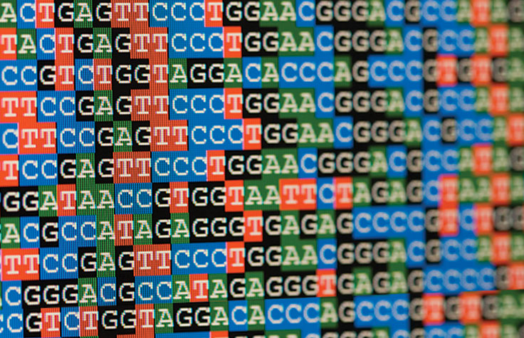
Chapter 7. Advanced Frequent Pattern Mining: Sequential Patterns and Graph Patterns
Meng Jiang
CSE 40647/60647 Data Science Fall 2017
Introduction to Data Mining

Slide 2
Pattern Mining Methods
Pattern | Closed Pattern (Concepts) | Idea 1: Pattern candidate generation and pruning | Idea 2: Vertical format to accelerate mining | Idea 3: Pattern growth
Frequent pattern (itemset) | ? | ? | ? | ?
Sequential pattern | ? | ? | ? | ?
Graph pattern | ? | ? | x | ?

Slide 3
Pattern Mining Methods
Pattern | Closed Pattern (Concepts) | Idea 1: Pattern candidate generation and pruning | Idea 2: Vertical format to accelerate mining | Idea 3: Pattern growth
Frequent pattern (itemset) | Closed frequent itemset | Apriori | ECLAT | FP-Growth
Sequential pattern | Closed seq. pattern | ? | ? | ?
Graph pattern | Closed graph pattern | ? | x | ?

Slide 4
Advanced Frequent Pattern Mining
Mining Diverse Patterns
Constraint-Based Frequent Pattern Mining
Sequential Pattern Mining
Graph Pattern Mining

Slide 5
Sequential Patterns: Applications
Sequential pattern mining has broad applications
Customer shopping sequences
Purchase a laptop first, then a digital camera, and then a smartphone, within 6 months
Medical treatments, natural disasters (e.g., earthquakes), science & engineering processes, stocks and markets, ...
Weblog click streams, calling patterns, …
Software engineering: Program execution sequences, …
Biological sequences: DNA, protein, …

Slide 6
Sequential Pattern and Sequential Pattern Mining
Sequential pattern mining: Given a set of sequences, find the complete set of frequent subsequences (i.e., satisfying the min_sup threshold)
An element may contain a set of items (also called events)
Items within an element are unordered and we list them alphabetically
Given support threshold min_sup = 2, <(ab)c> is a sequential pattern
A sequence database
SID | Sequence
10 | <a(abc)(ac)d(cf)>
20 | <(ad)c(bc)(ae)>
30 | <(ef)(ab)(df)cb>
40 | <eg(af)cbc>
A sequence: < (ef) (ab) (df) c b >
<a(bc)dc> is a subsequence of <a(abc)(ac)d(cf)>
http://hanj.cs.illinois.edu/pdf/span01.pdf

Slide 7
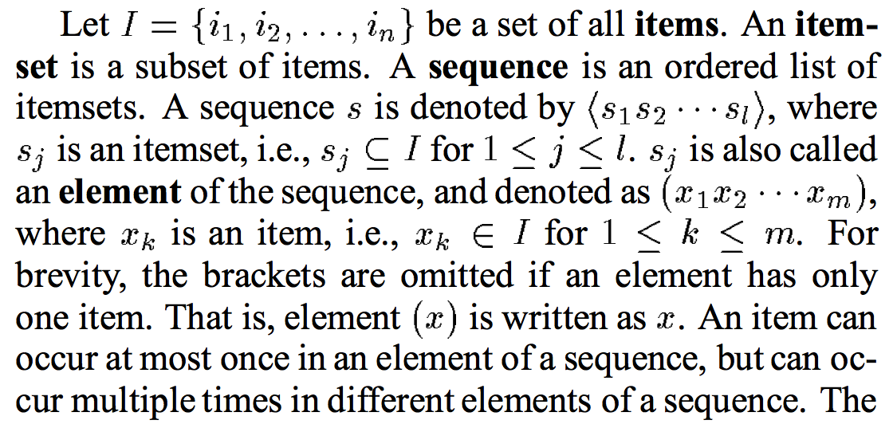
Sequence vs Element/Itemset/Event vs Item/Instance

Slide 8
Sequential Pattern Mining Algorithms
Algorithm requirement: Efficient, scalable, finding complete set, incorporating various kinds of user-specific constraints
The Apriori property still holds: If a subsequence s₁ is infrequent, none of s₁’s super-sequences can be frequent
Representative algorithms
Apriori-based Generalized Sequential Patterns: GSP (Srikant & Agrawal @ EDBT’96)
Vertical format-based mining: SPADE (Zaki@Machine Leanining’00)
Pattern-growth methods: PrefixSpan (Pei, et al. @TKDE’04)
Mining closed sequential patterns: CloSpan (Yan, et al. @SDM’03)
Constraint-based sequential pattern mining

Slide 9
GSP: Apriori-Based Sequential Pattern Mining
SID | Sequence
10 | <(bd)cb(ac)>
20 | <(bf)(ce)b(fg)>
30 | <(ah)(bf)abf>
40 | <(be)(ce)d>
50 | <a(bd)bcb(ade)>
Initial candidates: All singleton sequences
<a>, <b>, <c>, <d>, <e>, <f>, <g>, <h>
Scan DB once, count support for each candidate
Generate length-2 candidate sequences
min_sup = 2
 | <a> | <b> | <c> | <d> | <e> | <f>
<a> | <aa> | <ab> | <ac> | <ad> | <ae> | <af>
<b> | <ba> | <bb> | <bc> | <bd> | <be> | <bf>
<c> | <ca> | <cb> | <cc> | <cd> | <ce> | <cf>
<d> | <da> | <db> | <dc> | <dd> | <de> | <df>
<e> | <ea> | <eb> | <ec> | <ed> | <ee> | <ef>
<f> | <fa> | <fb> | <fc> | <fd> | <fe> | <ff>
Length-2 candidates:
36 + 15= 51
Without Apriori pruning:
8*8+8*7/2=92 candidates
Cand. | sup
<a> | 3
<b> | 5
<c> | 4
<d> | 3
<e> | 3
<f> | 2
<g> | 1
<h> | 1
 | <a> | <b> | <c> | <d> | <e> | <f>
<a> |  | <(ab)> | <(ac)> | <(ad)> | <(ae)> | <(af)>
<b> |  |  | <(bc)> | <(bd)> | <(be)> | <(bf)>
<c> |  |  |  | <(cd)> | <(ce)> | <(cf)>
<d> |  |  |  |  | <(de)> | <(df)>
<e> |  |  |  |  |  | <(ef)>
<f>
GSP (Generalized Sequential Patterns): Srikant & Agrawal @ EDBT’96)

Slide 10
GSP Mining and Pruning
Repeat (for each level (i.e., length-k))
Scan DB to find length-k frequent sequences
Generate length-(k+1) candidate sequences from length-k frequent sequences using Apriori
set k = k+1
Until no frequent sequence or no candidate can be found

Slide 11
Sequential Pattern Mining in Vertical Data Format: The SPADE Algorithm
A sequence database is mapped to: <SID, EID>
Grow the subsequences (patterns) one item at a time by Apriori candidate generation
SID | Sequence
1 | <a(abc)(ac)d(cf)>
2 | <(ad)c(bc)(ae)>
3 | <(ef)(ab)(df)cb>
4 | <eg(af)cbc>
min_sup = 2
Ref: SPADE (Sequential PAttern Discovery using Equivalent Class) [M. Zaki 2001]
https://pdfs.semanticscholar.org/39a0/80c17dec400a6f04af5fe5746dab3a5eb0dc.pdf

Slide 12
PrefixSpan: A Pattern-Growth Approach
Prefix and suffix
Given <a(abc)(ac)d(cf)>
Prefixes: <a>, <aa>, <a(ab)>, <a(abc)>, …
Prefixes-based projection
PrefixSpan Mining: Prefix Projections
Step 1: Find length-1 sequential patterns
<a>, <b>, <c>, <d>, <e>, <f>
Step 2: Divide search space and mine each projected DB
<a>-projected DB,
<b>-projected DB,
…
<f>-projected DB, …
SID | Sequence
10 | <a(abc)(ac)d(cf)>
20 | <(ad)c(bc)(ae)>
30 | <(ef)(ab)(df)cb>
40 | <eg(af)cbc>
Prefix | Suffix (Projection)
<a> | <(abc)(ac)d(cf)>
<aa> | <(_bc)(ac)d(cf)>
<ab> | <(_c)(ac)d(cf)>
PrefixSpan (Prefix-projected Sequential pattern mining) Pei, et al. @TKDE’04
http://hanj.cs.illinois.edu/pdf/span01.pdf

Slide 13
Advanced Frequent Pattern Mining
Mining Diverse Patterns
Constraint-Based Frequent Pattern Mining
Sequential Pattern Mining
Graph Pattern Mining

Slide 14
Frequent (Sub)Graph Patterns
Given a labeled graph dataset D = {G₁, G₂, …, G_{n}}, the supporting graph set of a subgraph g is D_{g} = {G_{i} | g ⊆ G_{i}, G_{i} ∈D}.
support(g) = |D_{g}|/ |D|
A (sub)graph g is frequent if support(g) ≥ min_sup Ex.: Chemical structures
Alternative:
Mining frequent subgraph patterns from a single large graph or network
Graph Dataset
(A)
(B)
(C)
min_sup = 2
Frequent Graph Patterns
(1)
(2)

Slide 15
Graph Pattern Mining: Applications
Bioinformatics
Gene networks, protein interactions, metabolic pathways
Chem-informatics: Mining chemical compound structures
Social networks, web communities, tweets, …
Cell phone networks, computer networks, …
Web graphs, XML structures, semantic Web, information networks
Software engineering: program execution flow analysis
Building blocks for graph classification, clustering, compression, comparison, and correlation analysis
Graph indexing and graph similarity search

Slide 16
Graph Pattern Mining Algorithms: Different Methodologies
Generation of candidate subgraphs
Apriori vs. pattern growth (e.g., FSG vs. gSpan)
Search order
Breadth vs. depth
Elimination of duplicate subgraphs
Passive vs. active (e.g., gSpan (Yan&Han’02))
Order of pattern discovery
Path → tree → graph (e.g., GASTON (Nijssen&Kok’04))

Slide 17
Apriori-Based Approach
The Apriori property (anti-monotonicity): A size-k subgraph is frequent if and only if all of its subgraphs are frequent
A candidate size-(k+1) edge/vertex subgraph is generated if its corresponding two k-edge/vertex subgraphs are frequent
Iterative mining process:
Candidate-generation → candidate pruning → support counting → candidate elimination
(k+1)-edge
k-edge
G₁
G
G₂
G’
…
G’’
G_{n}
Join

Slide 18
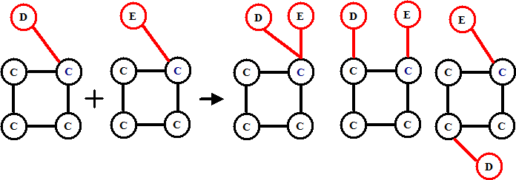
Candidate Generation: Vertex Growing vs. Edge Growing
Methodology: breadth-search, Apriori joining two size-k graphs
Many possibilities at generating size-(k+1) candidate graphs
Generating new graphs with one more vertex
AGM (Inokuchi, et al., PKDD’00)
Generating new graphs with one more edge
FSG (Kuramochi and Karypis, ICDM’01)
Performance shows via edge growing is more efficient

Slide 19
Pattern-Growth Approach
Depth-first growth of subgraphs from k-edge to (k+1)-edge, then (k+2)-edge subgraphs
Major challenge
Generating many duplicate subgraphs
Major idea to solve the problem
Define an order to generate subgraphs
DFS spanning tree: Flatten a graph into a sequence using depth-first search
gSpan (Yan & Han: ICDM’02)
(k+2)-edge
(k+1)-edge
…
G₁
k-edge
duplicate
graphs
G₂
G
…
G_{n}
…
http://cs.ucsb.edu/~xyan/papers/gSpan-short.pdf

Slide 20
Why Mining Closed Graph Patterns?
Challenge: An n-edge frequent graph may have 2^{n} subgraphs
Motivation: Explore closed frequent subgraphs to handle graph pattern explosion problem
A frequent graph G is closed if there exists no supergraph of G that carries the same support as G
Lossless compression: Does not contain non-closed graphs, but still ensures that the mining result is complete
Algorithm CloseGraph: Mines closed graph patterns directly
If this subgraph is closed in the graph dataset, it implies that none of its frequent super-graphs carries the same support

Slide 21
CloseGraph: Directly Mining Closed Graph Patterns
CloseGraph: Mining closed graph patterns by extending gSpan
Suppose G and G₁ are frequent, and G is a subgraph of G₁
If in any part of the graph in the dataset where G occurs, G₁ also occurs, then we need not grow G (except some special, subtle cases), since none of G’s children will be closed except those of G₁
G₁
At what condition can we
stop searching their children,
i.e., early termination?
k-edge
G₂
G
…
https://pdfs.semanticscholar.org/a1c1/5e63690c774b725fc91dcc77a629d01c3733.pdf
G_{n}
(k+1)-edge

Slide 22
Experiment and Performance Comparison
The AIDS antiviral screen compound dataset from NCI/NIH
The dataset contains 43,905 chemical compounds
Discovered Patterns: The smaller minimum support, the bigger and more interesting subgraph patterns discovered
20%
10%
5%
# of Patterns: Frequent vs. Closed
Runtime: Frequent vs. Closed
Run time (sec)
Number of patterns
Minimum support
Minimum support

Slide 23
References: Sequential Pattern Mining
R. Srikant and R. Agrawal, “Mining sequential patterns: Generalizations and performance improvements”, EDBT’96
M. Zaki, “SPADE: An Efficient Algorithm for Mining Frequent Sequences”, Machine Learning, 2001
J. Pei, J. Han, B. Mortazavi-Asl, J. Wang, H. Pinto, Q. Chen, U. Dayal, and M.-C. Hsu, "Mining Sequential Patterns by Pattern-Growth: The PrefixSpan Approach", IEEE TKDE, 16(10), 2004
X. Yan, J. Han, and R. Afshar, “CloSpan: Mining Closed Sequential Patterns in Large Datasets”, SDM'03
J. Pei, J. Han, and W. Wang, "Constraint-based sequential pattern mining: the pattern-growth methods", J. Int. Inf. Sys., 28(2), 2007
M. N. Garofalakis, R. Rastogi, K. Shim: Mining Sequential Patterns with Regular Expression Constraints. IEEE Trans. Knowl. Data Eng. 14(3), 2002
H. Mannila, H. Toivonen, and A. I. Verkamo, “Discovery of frequent episodes in event sequences”, Data Mining and Knowledge Discovery, 1997

Slide 24
References: Graph Pattern Mining
C. Borgelt and M. R. Berthold, Mining molecular fragments: Finding relevant substructures of molecules, ICDM'02
J. Huan, W. Wang, and J. Prins. Efficient mining of frequent subgraph in the presence of isomorphism, ICDM'03
A. Inokuchi, T. Washio, and H. Motoda. An apriori-based algorithm for mining frequent substructures from graph data, PKDD'00
M. Kuramochi and G. Karypis. Frequent subgraph discovery, ICDM'01
S. Nijssen and J. Kok. A Quickstart in Frequent Structure Mining can Make a Difference. KDD'04
N. Vanetik, E. Gudes, and S. E. Shimony. Computing frequent graph patterns from semistructured data, ICDM'02
X. Yan and J. Han, gSpan: Graph-Based Substructure Pattern Mining, ICDM'02
X. Yan and J. Han, CloseGraph: Mining Closed Frequent Graph Patterns, KDD'03
X. Yan, P. S. Yu, J. Han, Graph Indexing: A Frequent Structure-based Approach, SIGMOD'04
X. Yan, P. S. Yu, and J. Han, Substructure Similarity Search in Graph Databases, SIGMOD'05

Slide 25

Higher-Order Organization of Complex Networks
Austin Benson, David Gleich, Jure Leskovec

Slide 26
Higher-Order Structures
Small subgraphs (motifs, graphlets) are building blocks of networks
Notes:
Networks are not composed only of edges but these edges form small subgraphs, which we call motifs or graphlets.
And these higher-order structures are building blocks of networks.
For example, here are all possible directed connected subgraphs on 3 nodes.

Slide 27
Higher-Order Structures
Higher-order structures are fundamental for control and function of complex systems:
Social networks [Watts, Strogatz ‘98]
Metabolic networks [Milo et al. ‘02]
Protein networks [Alon ‘07] [Vinayagama et al.’16]
Transportation networks [Rosvall ‘14]
Neural networks [Park, Friston ‘13]
Food webs [Stouffer et al. ‘12]
Notes:
Triangular motifs are crucial for social networks (5),
Feedforward loops have proven fundamental to understanding transcriptional regulation networks (4),
Two-hop paths are essential to understanding air traffic patterns (7).
Rich-club motifs are key to the behavior of the brain (6),
All these results based on simply counting the subgraphs in a different network.

Slide 28
Higher-Order Organization
Prior work is based on simply counting frequencies of individual subgraphs
We still lack understanding of higher-order organization of complex systems

Slide 29
This talk: Higher-order Organization
What is higher order organization of networks?
How do we extract it?

Slide 30
This talk: Modules of Motifs
Find modules based on motifs!
Network:
Motif:
[Serrour, Arenas, Gomez '11]

Slide 31
Modules of Motifs
Different motifs reveal different modular structures!

Slide 32
How do we find modules of network motifs?

Slide 33
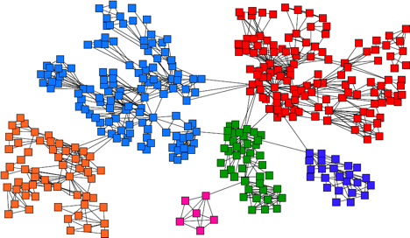
Background: Communities
Old idea: Find densely connected sets of nodes

Slide 34
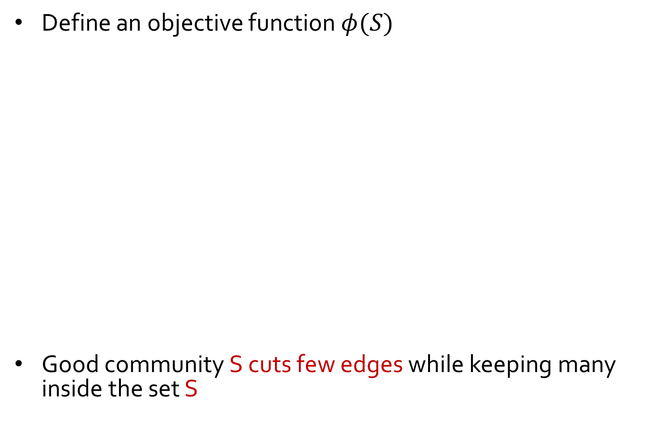
Background: Communities
Define an objective function $φ(S)$
Good community S cuts few edges while keeping many inside the set S
S
S

Slide 35
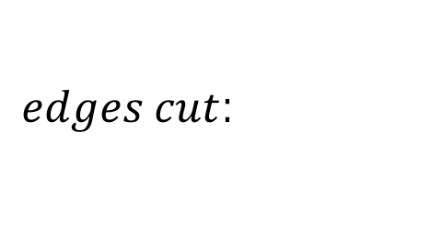
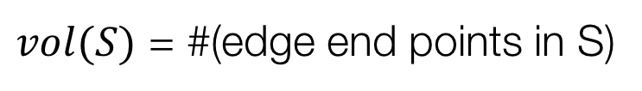
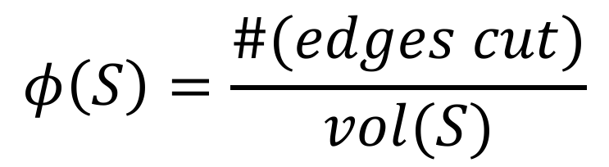
Defining an Objective Function
Conductance of a cluster S:
Lower conductance means a better cluster
$$φ\left(S\right)=\frac{\#(edges cut)}{vol(S)}$$
$edges cut$:
$vol(S)$ = #(edge end points in S)
Notes:
Notice, conductance is defined over individual edges.

Slide 36
How do we generalize conductance to network motifs?

Slide 37
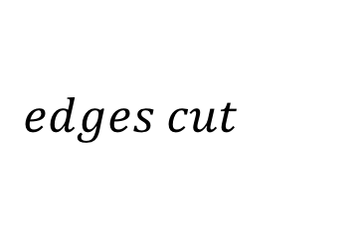
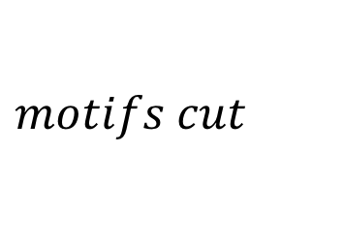
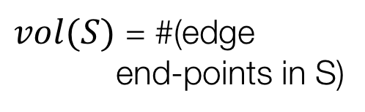
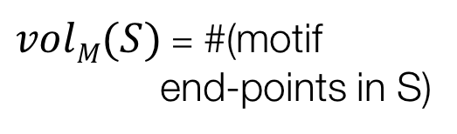
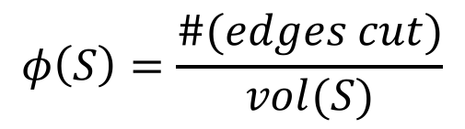
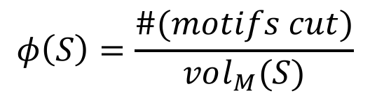
Defining Motif Conductance
Generalize Cut and Volume to motifs:
$$edges cut$$
$$motifs cut$$
$vol(S)$ = #(edge end-points in S)
$volM(S)$ = #(motif
end-points in S)
$$φ\left(S\right)=\frac{\#(edges cut)}{vol(S)}$$
$$φ\left(S\right)=\frac{\#(motifs cut)}{vol_{M}(S)}$$
[Benson, Gleich, Leskovec, Science 2016]

Slide 38
Motif Conductance: Example
Motif:
Network:

Slide 39
Higher-order Partitioning
How do we find clusters of motifs?
Given a motif M and a graph G
Find a set of nodes S that minimizes motif conductance
Bad news: Finding set S with the minimal motif conductance is computationally intractable (NP-hard)!
[Benson, Gleich, Leskovec, Science 2016]

Slide 40
Motif Spectral Clustering
Solution: Motif Spectral Clustering
Input: Graph G and motif M
Using G form a new weighted graph W
Apply spectral clustering on W
Output the clusters
Theorem: Resulting clusters will obtain near optimal motif conductance
[Benson, Gleich, Leskovec, Science 2016]

Slide 41
Motif Spectral Clustering
1
1
1
1
3
1
1
1
1
1
2
1
1
1
1
Graph G
Weighted graph W^{(M)}
W_{ij}^{(M)} = # of times edge (i,j) participates in motif M

Slide 42
Motif Spectral Clustering
Insight: Spectral clustering on weighted graph W^{(M)} finds clusters of low motif conductance:
1
1
1
1
3
1
1
1
1
1
2
1
1
1
1
Weighted graph W^{(M)}
W_{ij}^{(M)} = # of times edge (i,j) participates in motif M

Slide 43
Motif Spectral Clustering: 1
Step 1: Form weighted graph W^{(M)}

Slide 44
Motif Spectral Clustering: 2
Diagonal degree matrix
Step 2: Compute Fiedler vector f^{(M)} associated with λ₂ of the Laplacian of W^{(M)}

Slide 45
Motif Spectral Clustering: 3
Step 3: Sort nodes by values in f^{(M)}: f₁, f₂, …f_{n} Let S_{r} = {f₁, …, f_{r}} and compute the motif conductance of each S_{r}

Slide 46
Motif Cheeger Inequality
Theorem: The algorithm finds a set of nodes S for which
In other words: Clusters S found by our method are provably near optimal
… motif conductance of S found by our algorithm
… motif conductance of optimal set S*
Notes:
S is within a quadratic factor of optimal

Slide 47
Advantages
Easy to implement: ~10 lines of Matlab
Scalable to large networks (1.4B edge graphs)
General: Can be applied to directed, signed, and weighted networks
Code available: http://snap.stanford.edu/higher-order/

Slide 48
Summary
Generalization of community detection to higher-order structures
Motif-conductance objective admits a motif Cheeger inequality
Simple, fast, and scalable:

Slide 49
Applications
1) We don’t know a motif of interest
Food webs and new applications
2) We know the motif of interest
Regulatory transcription networks, connectome, social networks
3) We seek richer information from data
Transportation networks

Slide 50
Application 1: We do not know the motif of interest

Slide 51
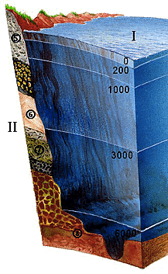
Application 1: Food webs
Florida Bay food web:
Nodes: species in the ecosystem
Edges: carbon exchange (who eats whom)
Different motifs capture different energy flow patterns:

Slide 52
Florida Bay Food Web
Which motif organizes the food web?
Approach:
Run motif spectral clustering separately for each of the 13 motifs
Examine the Sweep profile to see which motif gives best clusters

Slide 53
Florida Bay Food Web

Slide 54
Food Web: Observations
Observation: Network organizes based on motif M₆ (but not M₅ or M₈)
There exist good cuts for M₆ but not for M₅ or M₈

Slide 55
Food Web: Clusters
Pelagic fishes
and benthic prey
Benthic Fishes
Micronutrient
sources
Benthic Macroinvertibrates
M₆ reveals known aquatic layers with higher accuracy (84% vs. 65%)
Notes:
Our framework identifies these modules with higher accuracy (84%) than existing methods (65–69%)

Slide 56
Structure of Aquatic Layers
Aquatic layers organize based on M₆
Many instances of M₆ inside
Few instances of M₆ cross

Slide 57
Application 2: Signed networks

Slide 58
(2) Gene Regulatory Networks
Nodes are groups of genes in mRNA
Edges are directed transcriptional regulation relationships
The “feedforward loop” motif represents biological function [Alon ‘07]

Slide 59
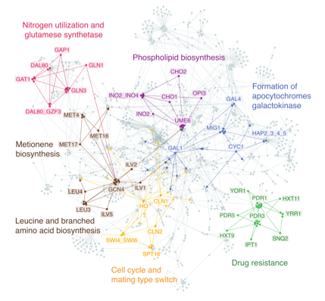
Yeast Regulatory Network
97% detection accuracy (vs. 68-82%)
Notes:
Clusters show functional modules consisting of several motifs (coherent feedforward loops), which were previously studied individually (45). The higher-order clustering framework identifies the functional modules with higher accuracy (97%) than existing methods (68–82%)

Slide 60
Structure of Modules
Feed forward loops:
Notes:
In these clusters, all edges have positive sign. The func- tionality of the motifs in the modules correspond to drug resistance (C) or cell cycle and mating type match (D). The clustering suggests that coherent feedforward loops function together as a single processing unit rather than as independent elements.

Slide 61
Application 3: Exploring richer information from data

Slide 62
(4) Transportation Networks
North American air transport network:
Nodes are airports
Unweighted directed edges reflect reachability
(Based on Freyet al.’s 2007)

Slide 63
Transportation Networks
Want to understand hub-and-spoke structure of the network
Use “anchored” motifs:

Slide 64
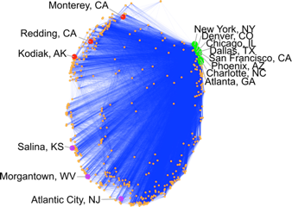
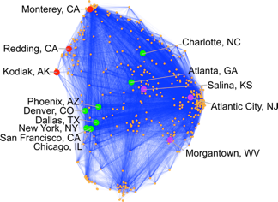
Transportation Networks
Motif-based spectral embedding
Edge-based spectral embedding
West coast non-hubs
Atlanta, the top hub, is
next to Salina, a non-hub.
Secondary spectral coordinate
Top U.S. hubs
Primary spectral coordinate
East coast non-hubs

Slide 65
(3) Neuronal Networks
Bi-Fan motif is overexpressed in C. Elegans network [Milo ‘02]
Cluster the network based on this motif!
Notes:
The cluster contains three ring motor neurons (RMEL/V/R; cyan) with many outgoing connections, serving as the source of information;
Six inner labial sensory neurons (IL2DL/VR/R/DR/VL; orange) with many incoming connections, serving as the destination of information; and four URA neurons (purple) acting as intermediaries.
These RME neurons have been proposed as pioneers for the nerve ring (20),
while the IL2 neurons are known regulators of nictation (21),
and the higher-order cluster exposes their organization.
The cluster also reveals that RIH serves as a critical intermediary of information processing.
This neuron has incoming links from all three RME neurons, outgoing connections to five of the six IL2 neurons, and the largest total number of connections of any neuron in the cluster.

Slide 66
C. Elegans: Best Cluster
Node locations represent spatial coordinates of corresponding neurons

Slide 67
C. Elegans Network
Ring motor (RME*) neurons act as inputs
Inner labial sensory (IL2*) neurons are the destinations
URA neurons act as intermediaries
Notes:
The cluster contains three ring motor neurons (RMEL/V/R; cyan) with many outgoing connections, serving as the source of information;
Six inner labial sensory neurons (IL2DL/VR/R/DR/VL; orange) with many incoming connections, serving as the destination of information;
and four URA neurons (purple) acting as intermediaries.
These RME neurons have been proposed as pioneers for the nerve ring (20),
while the IL2 neurons are known regulators of nictation (21),
and the higher-order cluster exposes their organization.
The cluster also reveals that RIH serves as a critical intermediary of information processing.
This neuron has incoming links from all three RME neurons, outgoing connections to five of the six IL2 neurons

Slide 68
Summary
Community detection of higher-order structures
Provably finds good clusters
Simple, fast, and scalable
Can be applied to directed, signed, and weighted networks

Slide 69
Paper, Data, Code
Paper: Higher-order Organization of Complex Networks. Austin R. Benson, David F. Gleich, and Jure Leskovec. Science, 2016.
Code & Data: http://snap.stanford.edu/higher-order/

